Slide 1
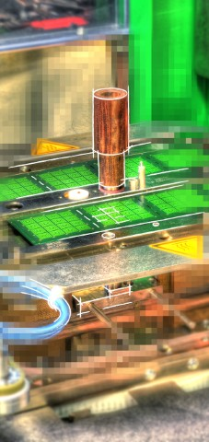
CHAMELEON
TC Toolbox
V1Z

Slide 2
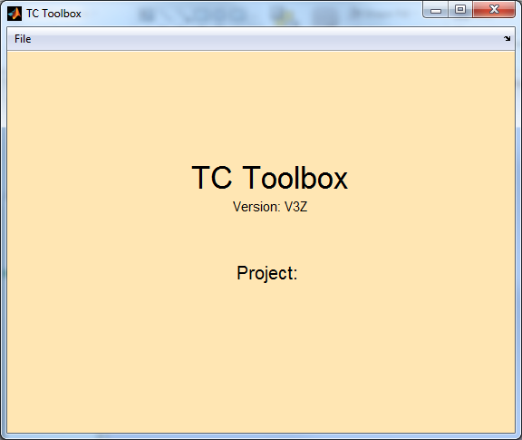
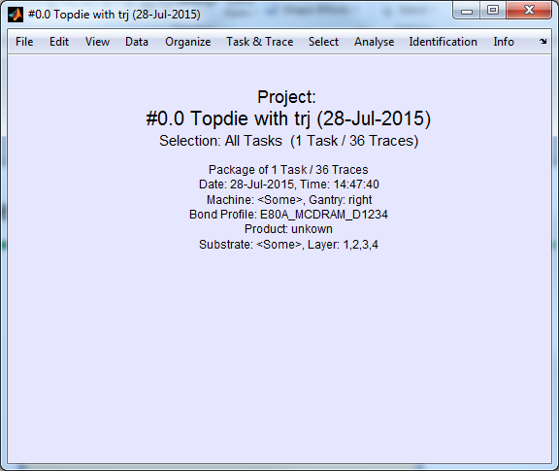
Collection of Traces in a Package
>> tctool % start TC toolbox
=> File>Collect... % click on a file in a package directory

Slide 3
Concept
Multiple Traces can be loaded into the tool
Organized by tasks
Selection by filter criteria: task, type, layer gantry, idividual marking
Individual de-selection of traces using marks

Slide 4
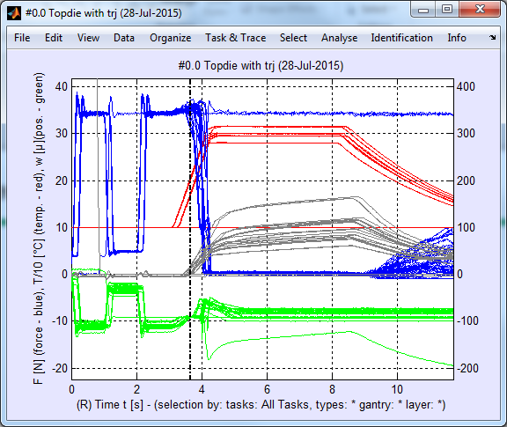
Overview
Analyze>Plot T,F,w,z % overview of current selection
we see some junk traces, e.g. a sacrificed die

Slide 5
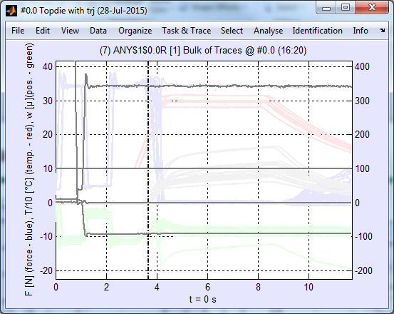
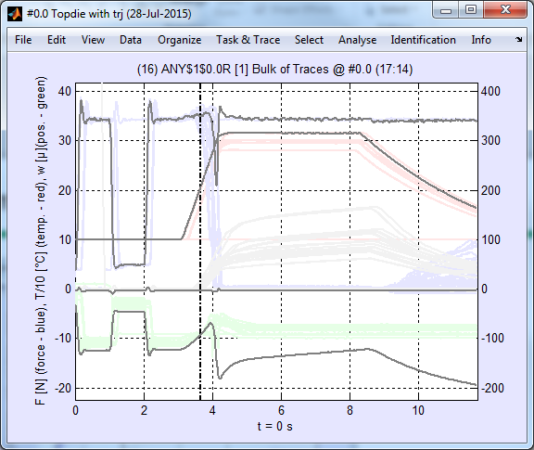
Unmark „Junk Traces“
use cursor up/down to browse through single traces
=> unmark trace with constant temperature (ctrl-m>
=> unmark sacrificed die (ctrl-m)

Slide 6
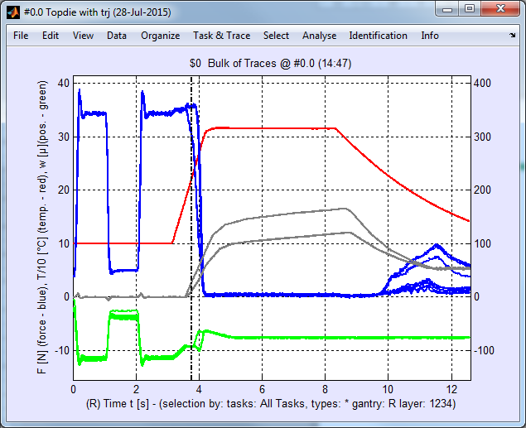
Select a Layer
select layer 1 (Select>Layer>1) and refresh (enter)
=> aha – there are two different parameter setups

Slide 7
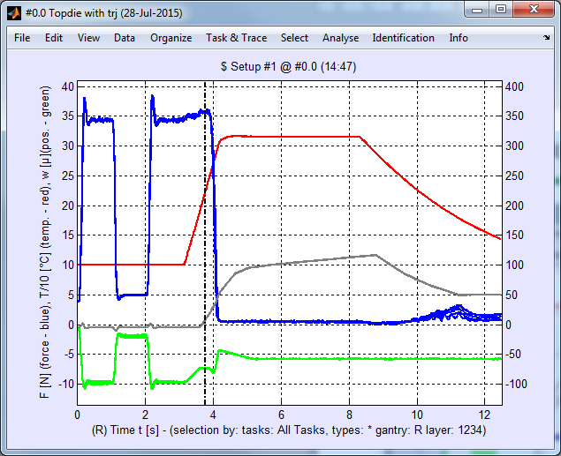
Create New Tasks
create task „Layer #1 @ Setup #1“ (File>New>New Task)
unmark „unwanted“ tasks (ctrl-m)

Slide 8
Thank You

